Slide 2
Scenario1-Set up Project Environment
Go to File-> Go to New-> Others -> Maven Project to create a new Java project.
Add the dependencies to pom.xml file
Create the packages under the src/main/java folder and the src/test/java folder.
Design driver utility class and configure driver exe files to launch
respective browser by webdriver.

Slide 3
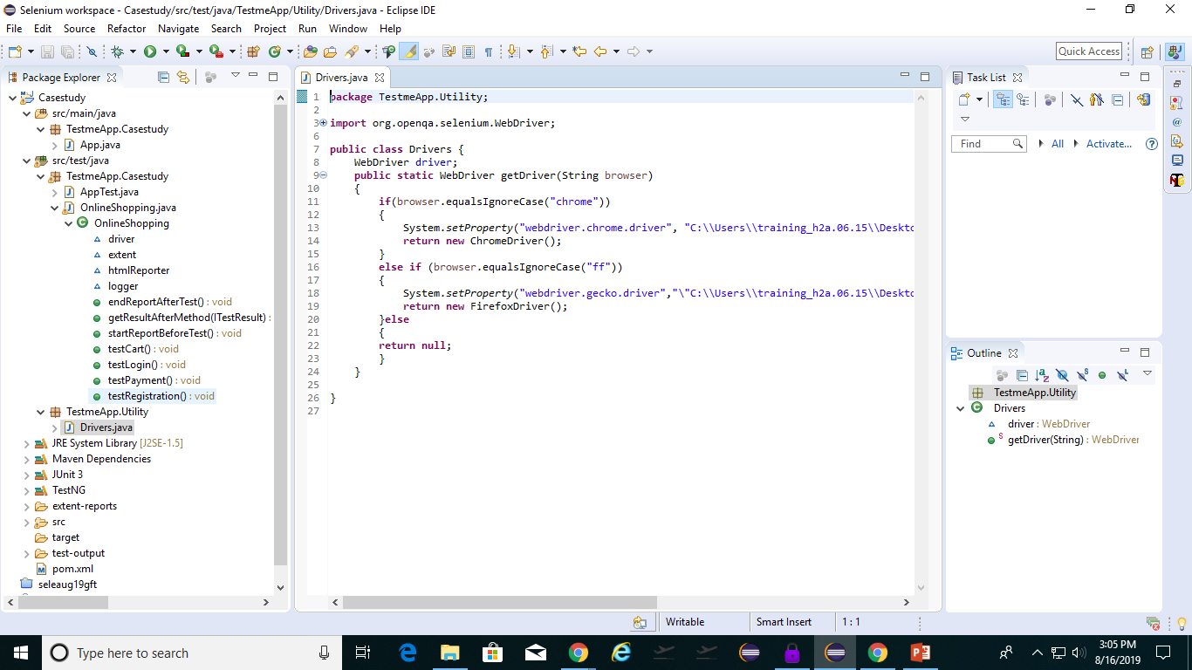
Screenshot for Scenario1

Slide 4
Scenario2-Initialize all Data members like Web driver , Extent Html Reporter, Extent Reports and Extent Test
Selenium WebDriver is a collection of open source APIs which are used to automate the testing of a web application.
Selenium provides inbuilt reports using frameworks such as JUnit and TestNG.
Extent Reports is a customizable HTML report which can be integrated into Selenium WebDriver using JUnit and TestNG frameworks.
Extent Reports: By using this class we set the path where our reports need to generate.
Extent Test: By using this class we could generate the logs in the report.

Slide 5
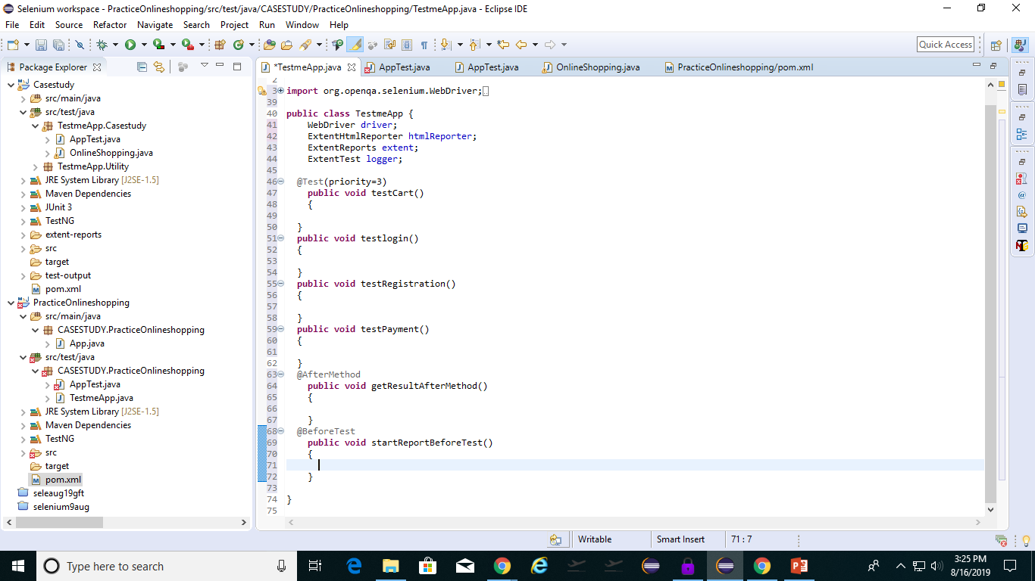
Scenario2

Slide 6
Scenario3-Automate and Verify Registration process in TestMe App.
Actions are created to access
Selenium locator Link Text is used to find the element Sign Up.
Keyboard Actions are performed for selecting security questions.
driver.findElement() is used to find the first web element.

Slide 7
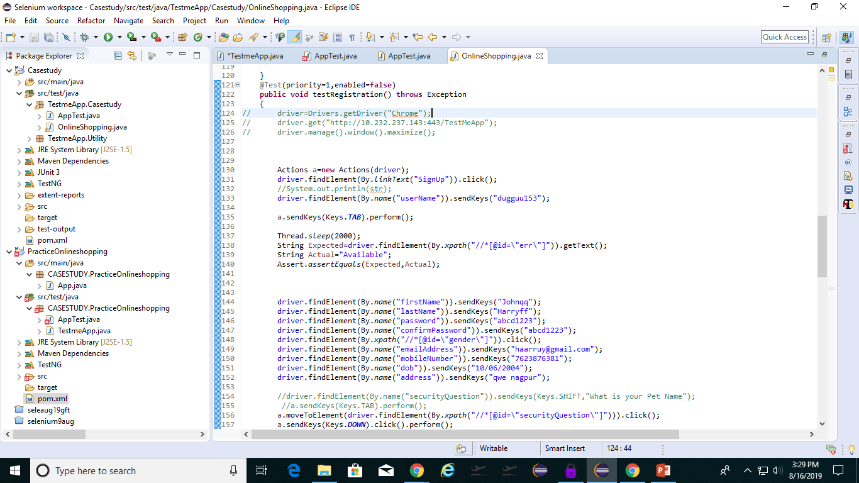
Scenario3

Slide 8
Scenario4-Automate and verify Login functionality with registered user id.
Login can be done only after successful registration.
Assertions are used to verify the login functionality.
Visibility of sign out link on Home page ensures that user is logged in.
For locating username and password the name locator is being used.
Xpath locator is used to locate the submit button.

Slide 9
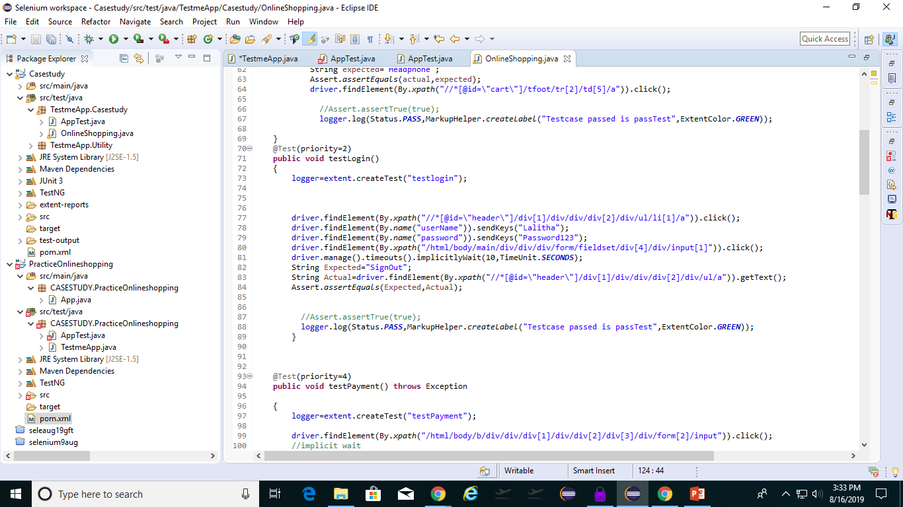
Scenario4

Slide 10
Scenario5-Design testcase to automate and verify add products in Testme App.
Keyboard Actions are used to select Products from all categories.
Sub-Menus are accessed using

Slide 11
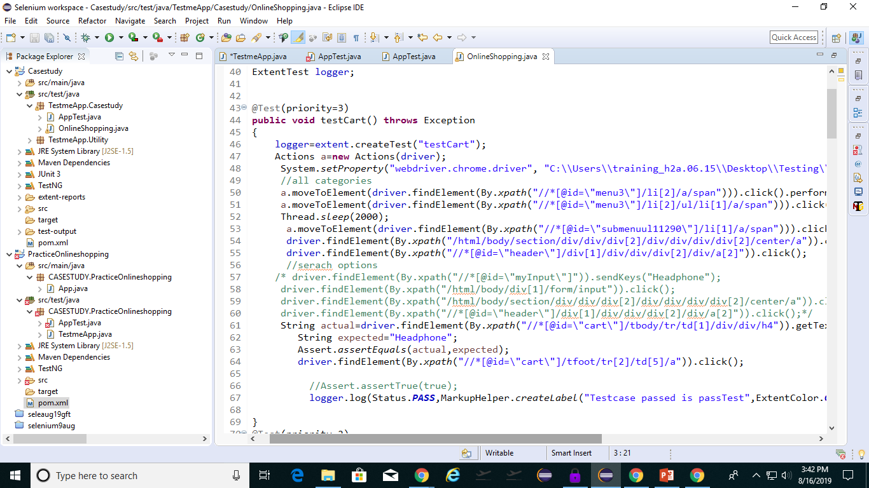
Scenario5-Screenshot

Slide 12
Scenario6-Automate and Verify Payment page and Purchase Products to Cart
Create test method test payment() to automate the page.
Implicit wait is given to the page to i tell to the web driver to wait for certain amount of time before it throws a "No Such Element” Exception.
Username and Password attributes of bank are accessed by name.
Assertions are used to verify that the order is confirmed.
Submit of details is accessed by using xpath for the value.
Test case is failed if the xpath for the attribute is given incomplete.

Slide 13
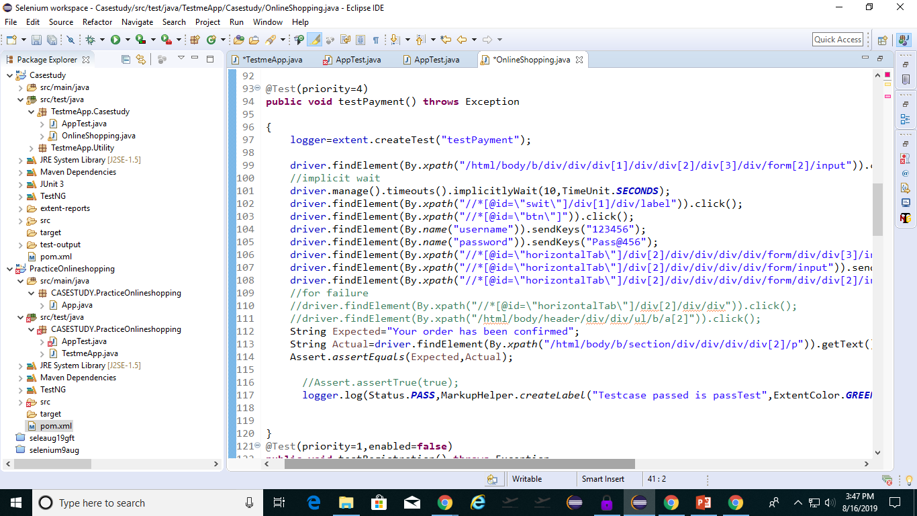
Scenario6-Automate and Verify Payment page and Purchase Products. to Cart

